Slide 1

The Food Desert Crisis: A Data-Driven Analysis and Modeling
- Team 23 Unthinkables
Anirudh
Harshith Maddala
Siddharth

Slide 2
TABLE OF CONTENTS
01
04
02
05
03
06
Introduction
Modeling
Dataset
Evaluation and Solutions
Visual Insights
Conclusion

Slide 3
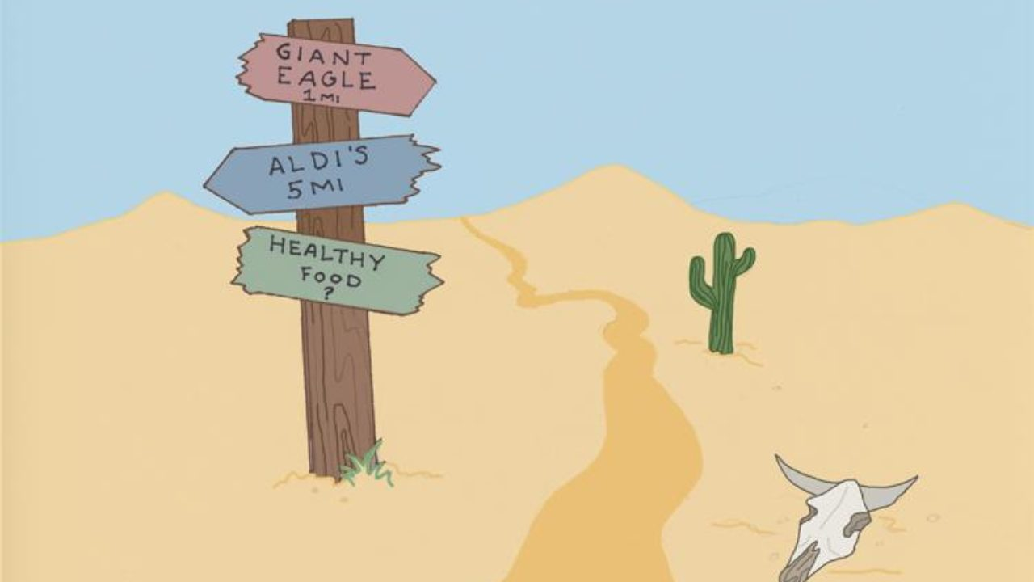
01
Introduction

Slide 4
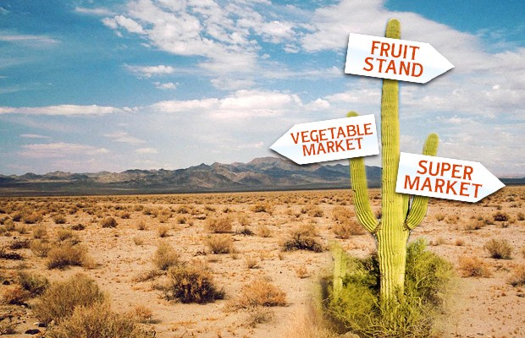
Understanding Food Deserts
Food deserts are geographic areas where residents have limited access to affordable and nutritious food.
Typically found in low-income communities lacking nearby supermarkets or grocery stores.
Residents often rely on fast food outlets or convenience stores with few healthy options.
According to the USDA, over 17 million Americans live in areas classified as food deserts.

Slide 5
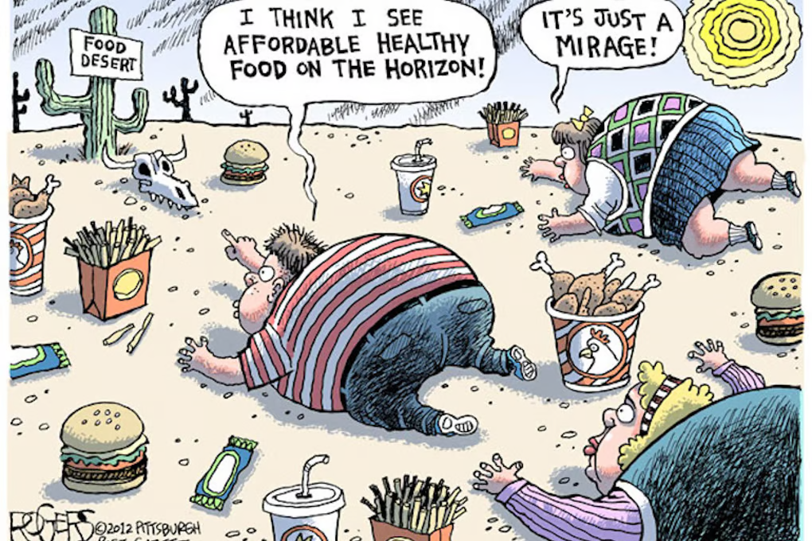
Impact of Food Desert
Families may be forced to choose between unhealthy convenience food or long travel for fresh produce.
That, in turn leads to poor nutrition and higher rates of obesity, diabetes, and heart disease.
Deepens cycles of poverty and poor health in underserved communities.
Children and seniors are especially vulnerable to the effects of food insecurity.
Limited food access affects educational outcomes, economic productivity, and overall well-being.

Slide 6
02
Dataset

Slide 7

Food Access Research Atlas
Food Environment Atlas
▪ Tract-level data on supermarket accessibility across the U.S.
▪ Includes indicators like poverty rate, vehicle access, SNAP usage, and proximity to food retailers.
▪ County-level data on health, economic, and food system indicators.
▪ Provides broader context—obesity rates, physical activity, food outlet density.
▪ Useful for extending tract-level insights to a regional scale.

Slide 8
Key Variables
Demographic Indicators:
Access & Infrastructure Indicators:
PovertyRate – % of population below the poverty line
MedianFamilyIncome – Income indicator for household economic strength
TractLOWI – Low-income population
TractKids, TractSeniors – Children and elderly population counts
TractWhite, TractBlack, TractHispanic, etc. – Racial/ethnic composition
LILATracts_1And10 – USDA food desert classification (low income + low access)
LILATracts_Vehicle - low income + a high percentage of residents have no vehicle access
LATracts1 - binary variable (low access within 1 mile)
TractHUNV – Households with no vehicle
Urban – Urban vs. rural designation
Food Support Indicator:
Derived Features:
TractSNAP – Number of households receiving food assistance (SNAP)
is_food_desert – Custom binary column (1 if tract meets USDA food desert criteria)
food_desert_severity – Composite score counting overlapping food access challenges

Slide 9
03
Visual Insights

Slide 10
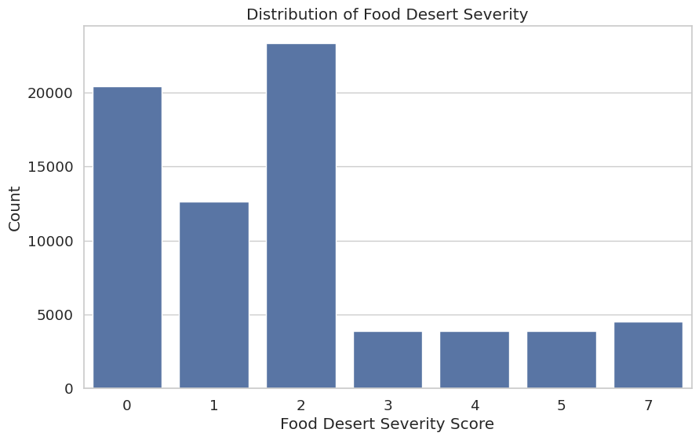
Distribution of Food Desert Severity

Slide 11
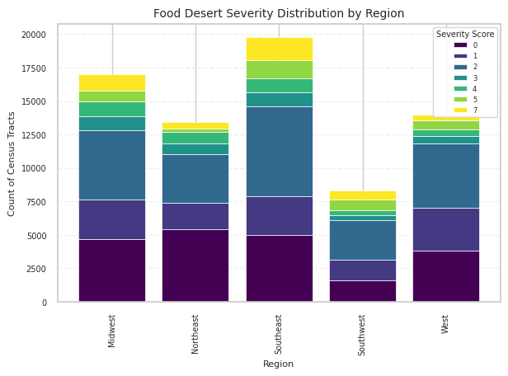
Food Desert Severity Distribution by Region:

Slide 12
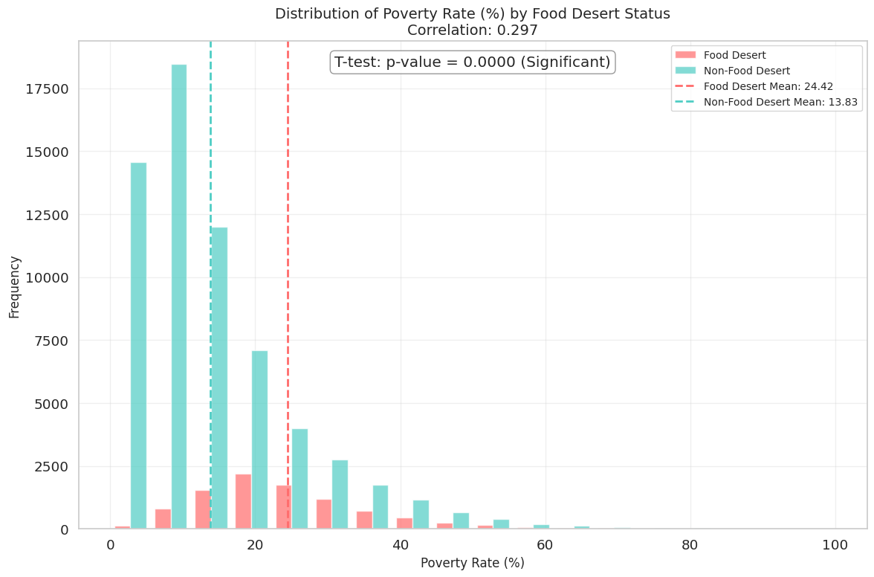
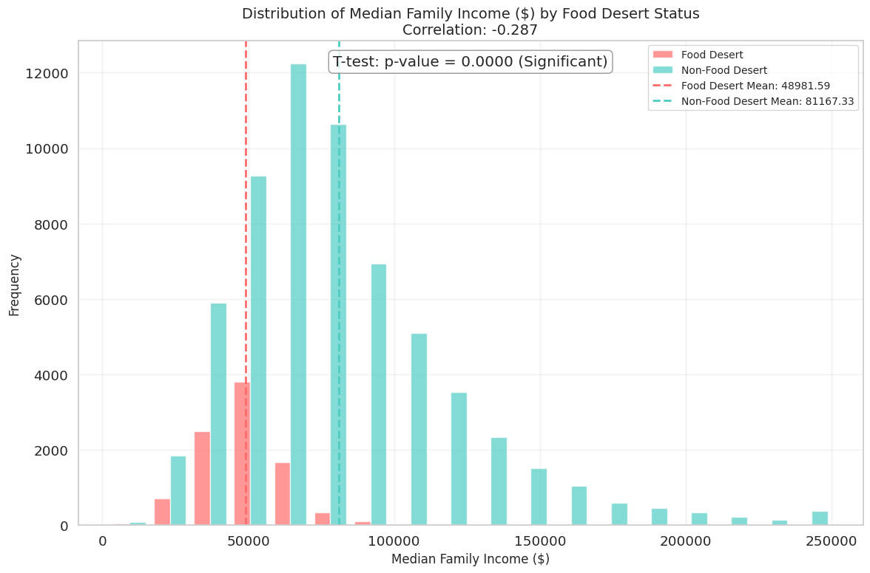
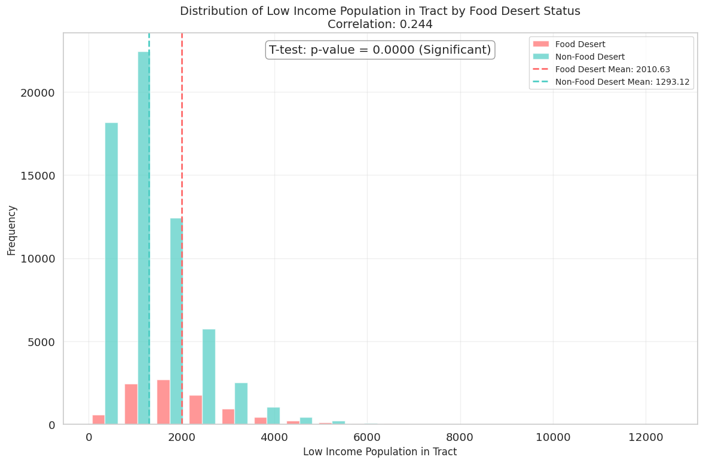
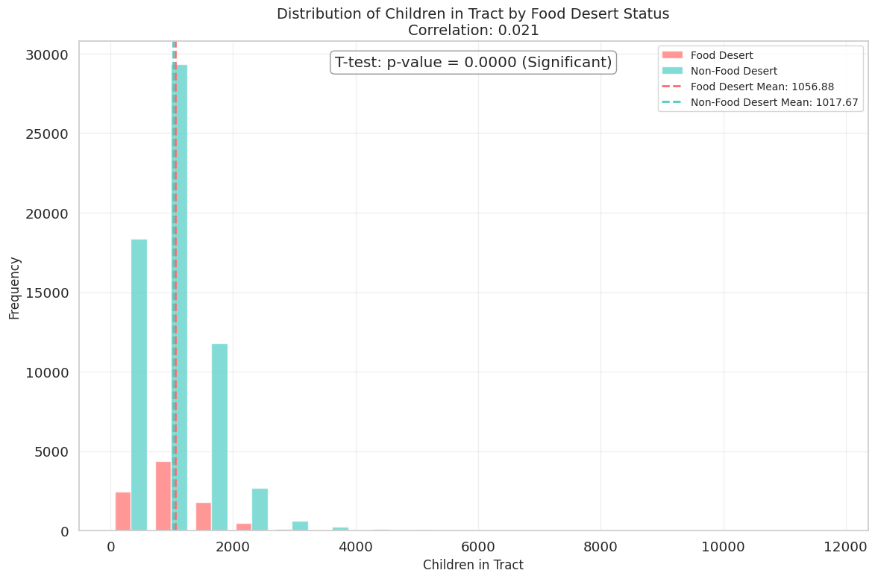
Food desert status by each Demographic factor:
Poverty rate (Correlation: 0.297)
Median Family Income (Correlation: -0.287)
Low Income Population (Correlation: 0.244)
Distribution of Children (Correlation: 0.021)

Slide 13
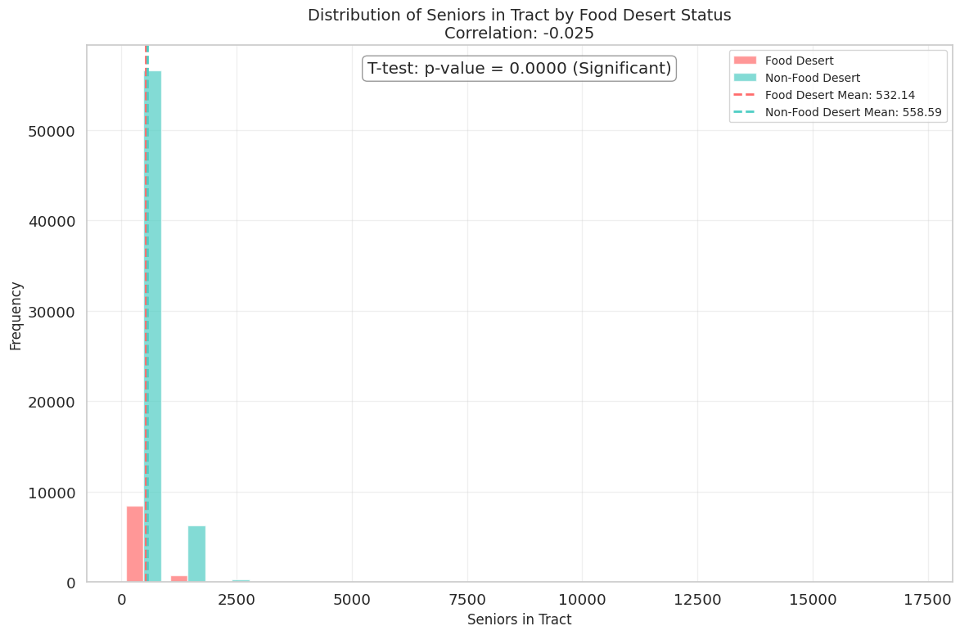
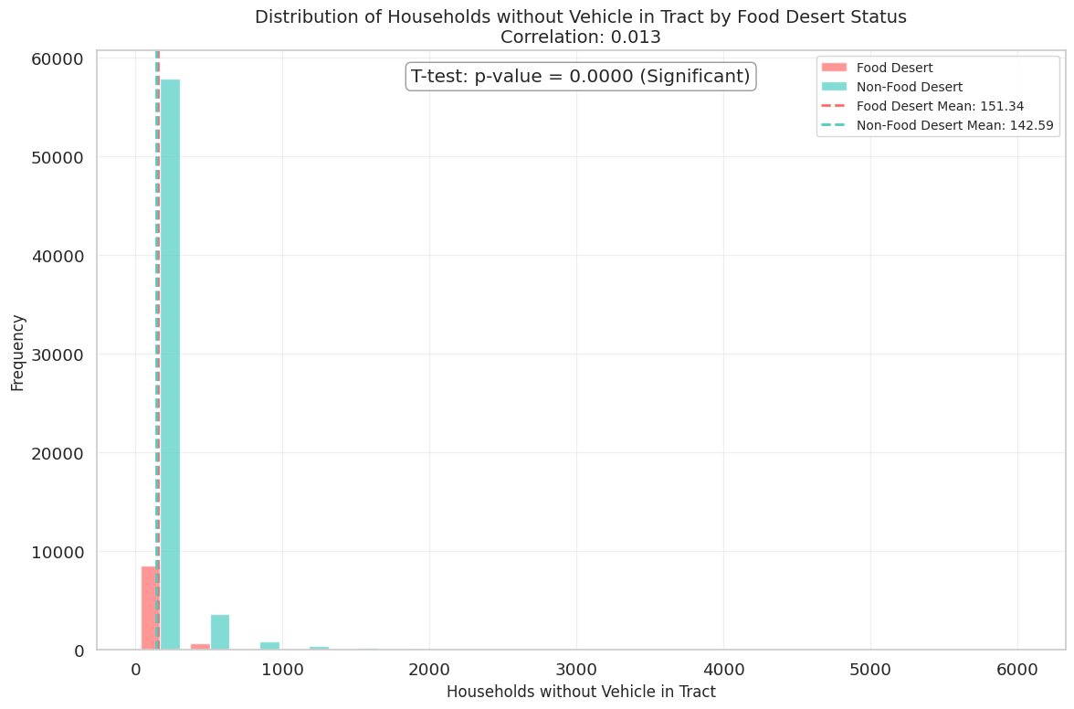
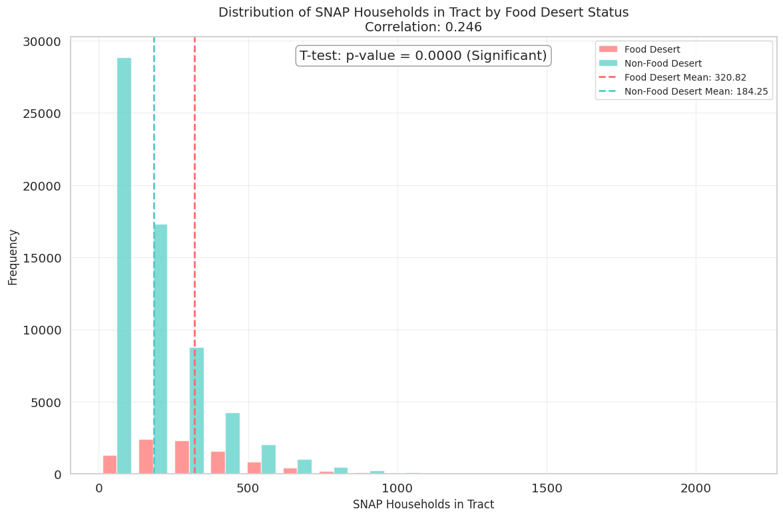
Food desert status by each Demographic factor:
Distribution of Seniors (Correlation: -0.025)
Households without vehicle in Tract (Correlation: 0.013)
SNAP Household in Tract (Correlation: 0.246)

Slide 14
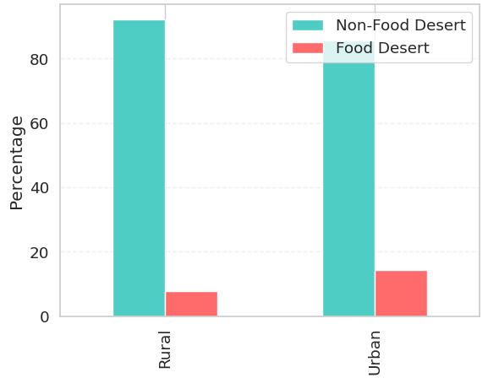
Rural VS Urban Food Desert Comparison

Slide 15
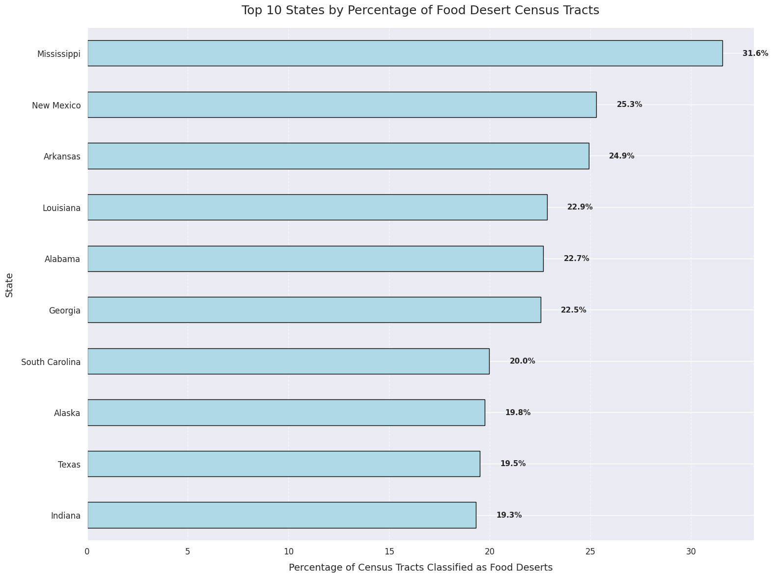
Top 10 states with Food Desert areas

Slide 16
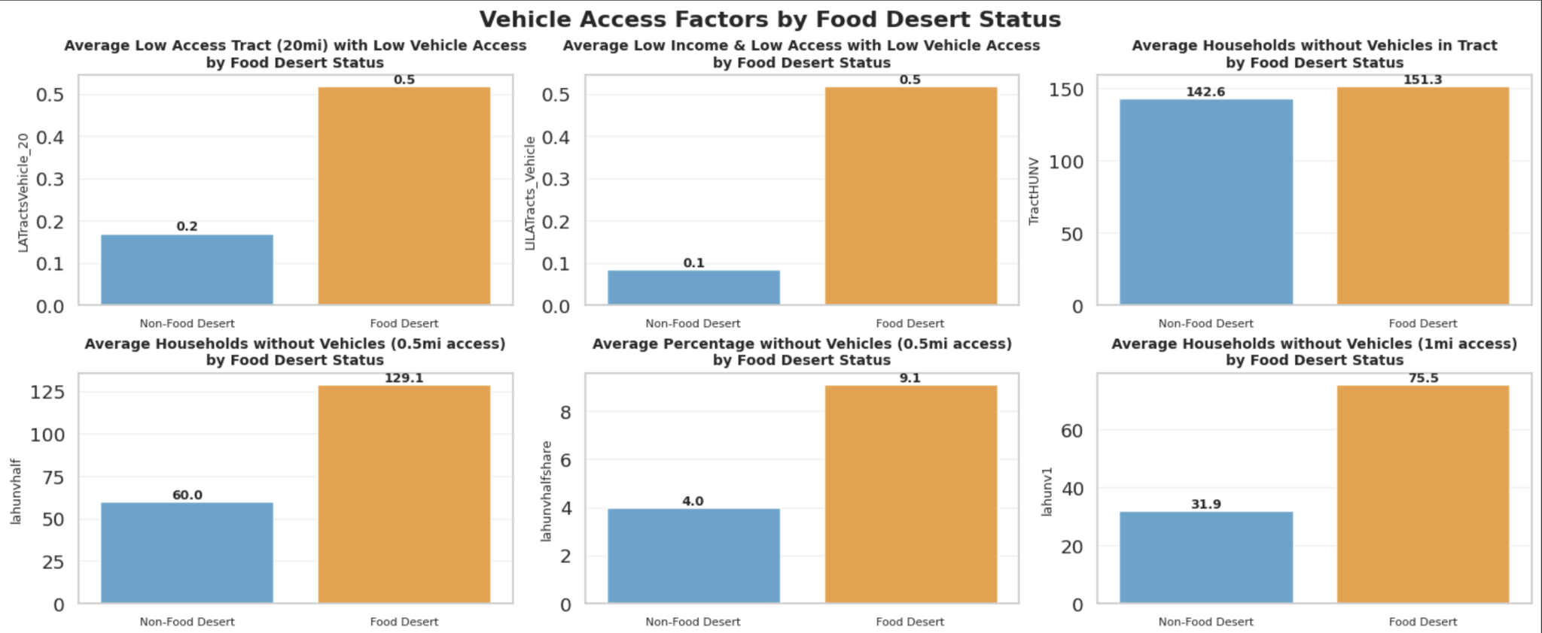
Vehicle Access Factors by Food Desert Status

Slide 17
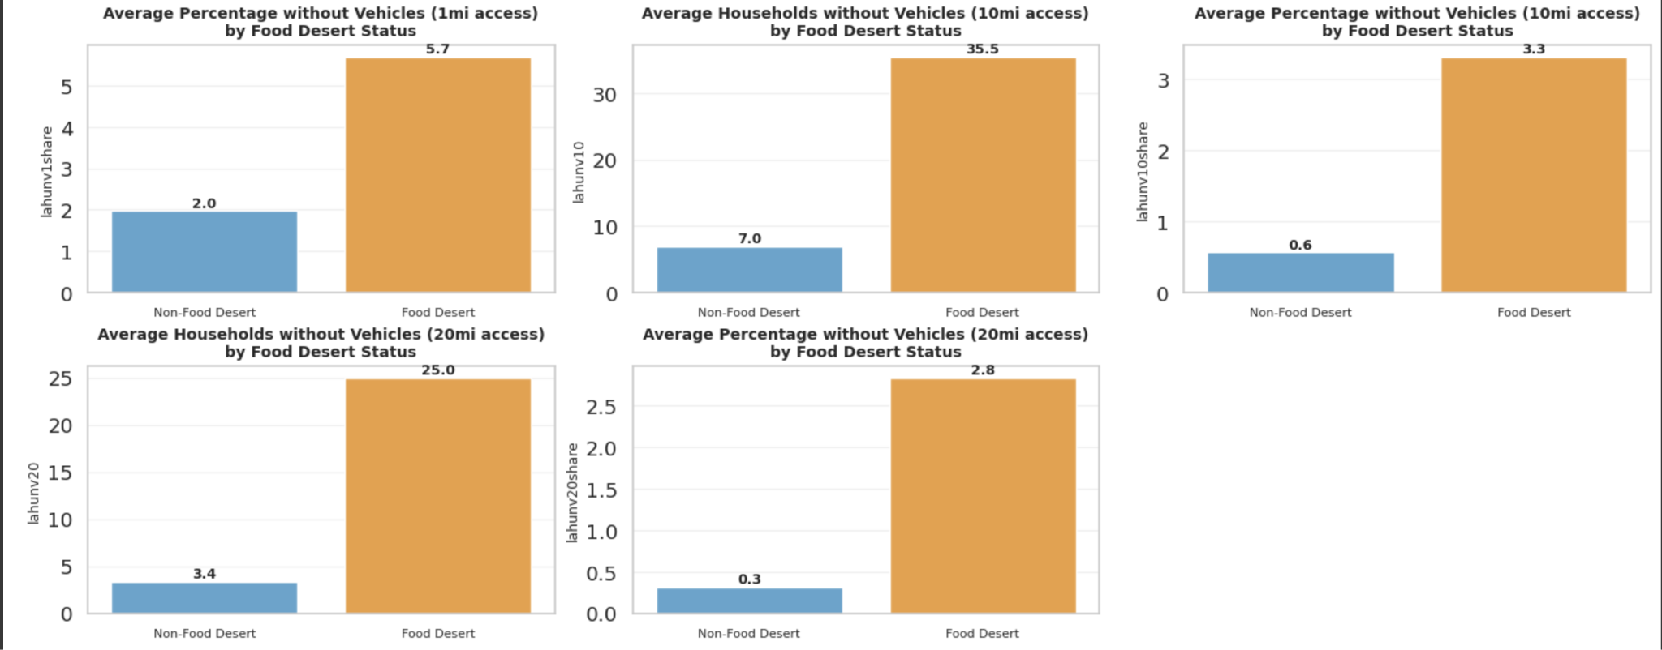
Vehicle Access Factors by Food Desert Status

Slide 18
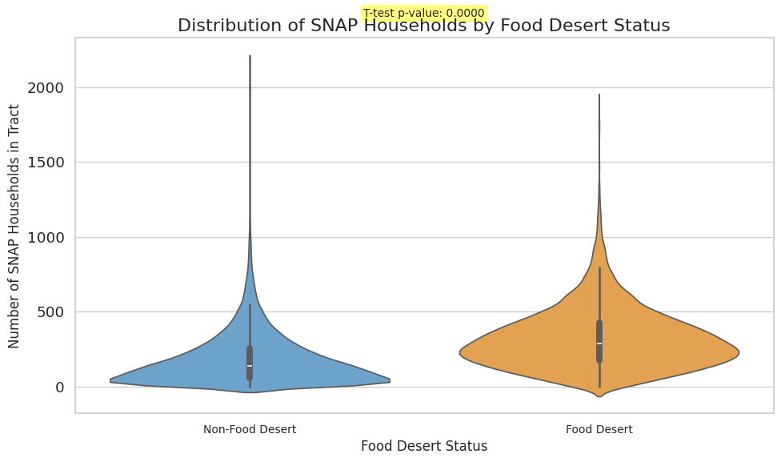
Distribution of SNAP Household by Food Desert Status

Slide 19
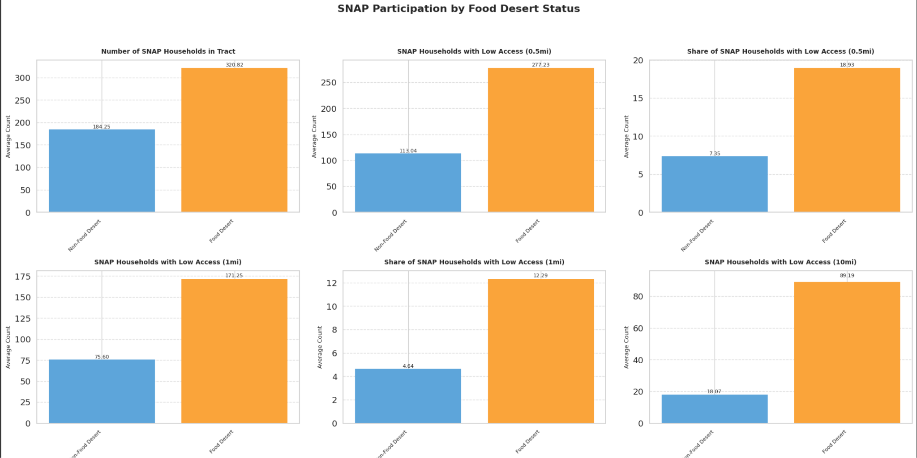
Distribution of SNAP household

Slide 20
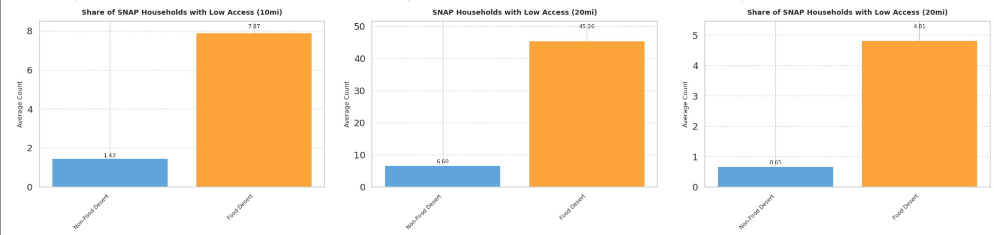
Distribution of SNAP household

Slide 21
04
Modeling

Slide 22
Objectives of the Model
Identifying & Predicting Food Deserts Efficiently
Understanding Key Factors Driving Food Insecurity
Predicting the Number of Households affected by Food Deserts

Slide 23
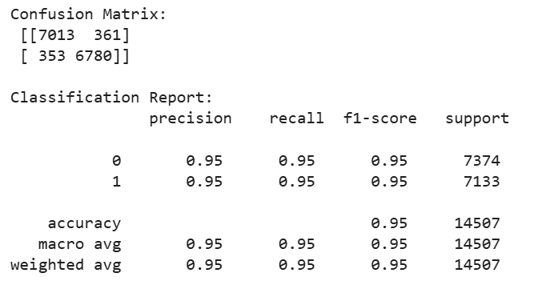
Classification Model :
Random
Forest Classifier
Accuracy: 95%

Slide 24
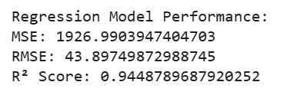
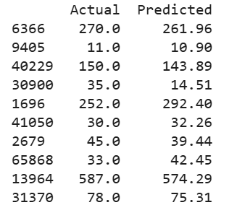
Predicting the number of households participating in SNAP
Model: Random Forest Regressor

Slide 25
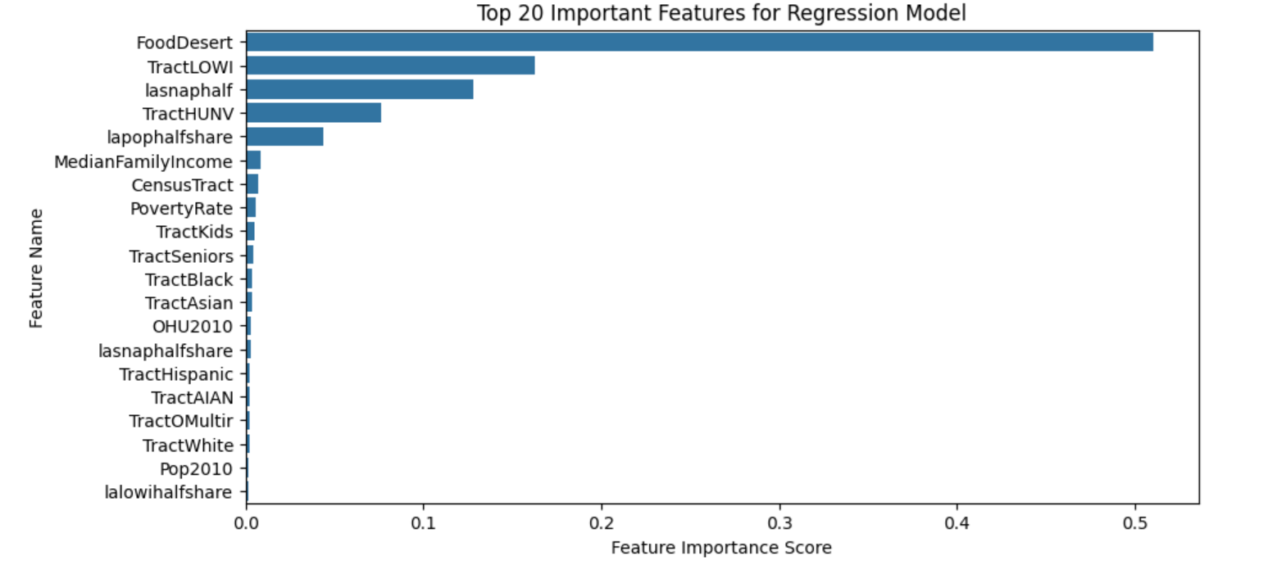
Top 20 Important Features impacting Food insecurity

Slide 26
05
Evaluation and Solutions

Slide 27
Focusing on regions(such as Southeast and Midwest) and states having highly concentrated Food deserts (such as Mississippi, New Mexico, Arkansas).

Slide 28
Concentrate more on high poverty areas, and areas lacking SNAP to ensure access to healthy food.
Median Family Income (Correlation:-0.287)

Slide 29
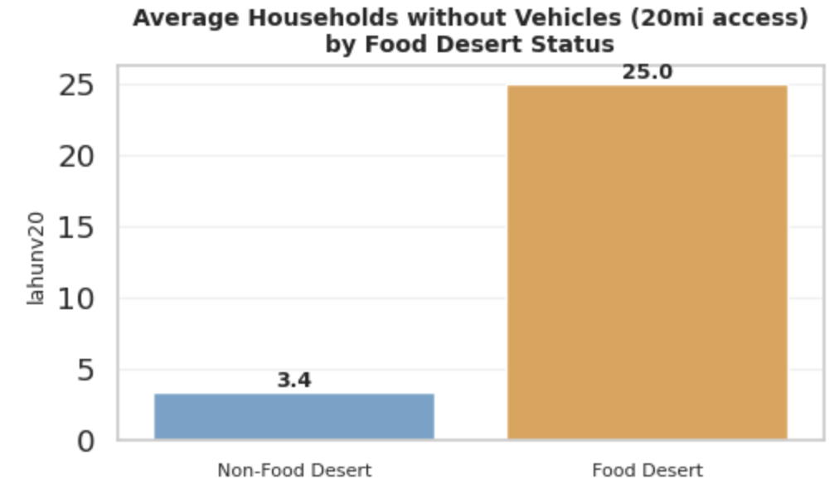
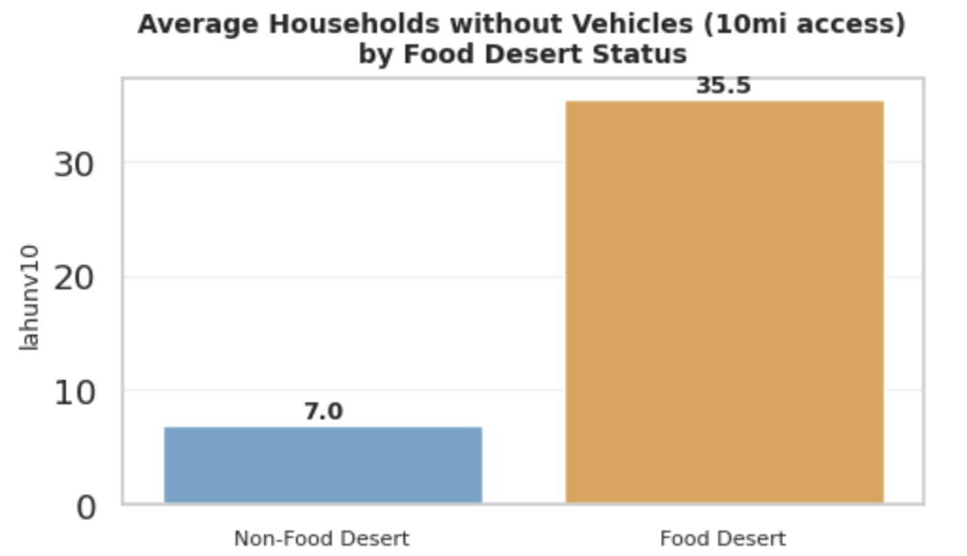
Address transportation related issues.
Provide subsidized ride programs, or strategic placement of mobile grocery units.

Slide 30
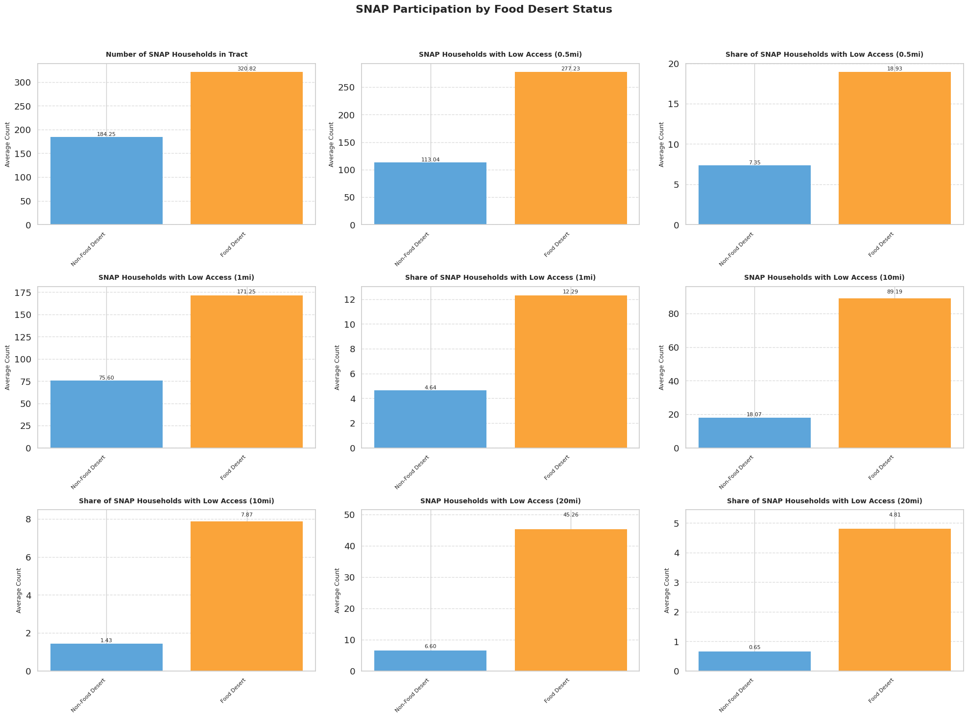
Restructure SNAP distribution infrastructure to ensure that outreach and benefit support extends beyond the typical 0.5-mile radius to reach SNAP-eligible households living 10 or even 20 miles away from food sources.

Slide 31
By using the classification and regression models built in this study, stakeholders can proactively identify census tracts at risk of becoming food deserts or experiencing heightened food insecurity.

Slide 32
06
Conclusion

Slide 33


Thank You

